Slide 1
Introduction
Nimish Narang
Software Developer

Slide 2

GOALS
Learn how to design and build an algorithm.
Build a bot to diagnose levels of dehydration.

Slide 3
WHY THIS TOPIC?
We can use algorithms to help solve problems.
Algorithms are embedded throughout modern medicine.
Diagnose patients
Analyze data, test results, and images
Run machines

Slide 4

PREREQUISITES
Basic Python knowledge
Python coding environment
Replit: https://replit.com/

Slide 5

4 STAGES OF PROJECT
MANAGEMENT
Definition
Design
Implementation
Evaluation

Slide 6
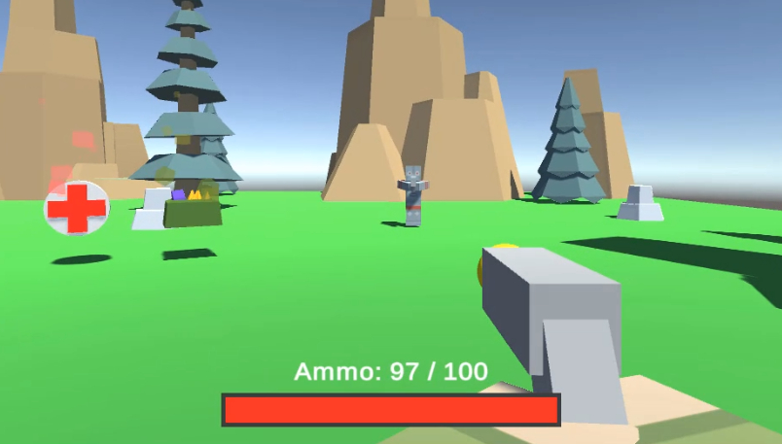
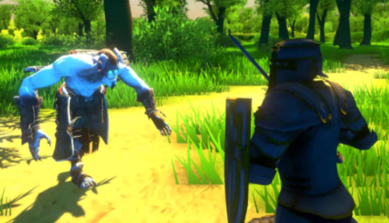
ZENVA COURSES
Build your own project, learn at your own pace and plan for success!
Notes:
Zenva is an online learning academy with over a million students. We feature a wide range of courses for people who are just starting out, or for people who want to learn something new. Our courses are versatile, allowing you to learn in really whatever way you want. You can choose to view the video tutorials, read the lesson summaries, or even follow along with the instructor with the included project files.

Slide 7
PROJECT DEFINITION

Slide 8
PROJECT DEFINITION - 1
We want to diagnose a user’s state of dehydration based on a short questionnaire.
Yes-or-no type questions
Previous responses determine next questions
Severe/some/no dehydration

Slide 9
PROJECT DEFINITION - 2
We want to retrieve and add dehydration diagnoses.
Display a list of patients and diagnoses
Store new diagnoses in the list

Slide 10
PROJECT DESIGN

Slide 11
PROJECT DESIGN
Our program will perform 2 main functions:
Run a new diagnosis and store results
Display a list of previous patients and diagnoses

Slide 12
HOW WILL IT WORK?
Text-based program that will run within the Terminal/CMD Prompt.
Display prompt/question
Process user text input

Slide 13
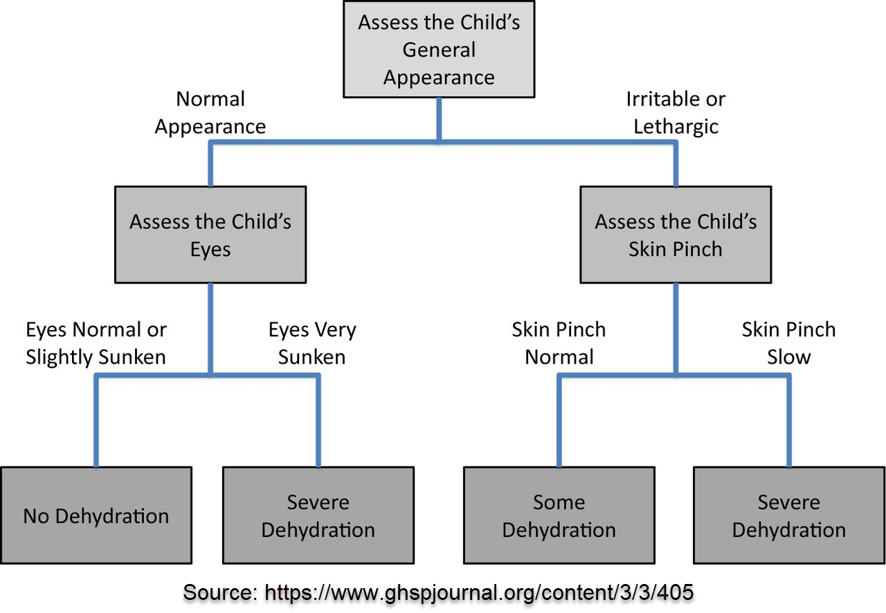
DIAGNOSIS ALGORITHM

Slide 14
ATTRIBUTION
https://www.ghspjournal.org/content/3/3/405
Empirically Derived Dehydration Scoring and Decision Tree Models for Children With Diarrhea: Assessment and Internal Validation in a Prospective Cohort Study in Dhaka, Bangladesh
Adam C Levine, Justin Glavis-Bloom, Payal Modi, Sabiha Nasrin, Soham Rege, Chieh Chu, Christopher H Schmid and Nur H Alam
Global Health: Science and Practice September 2015, 3(3):405-418; https://doi.org/10.9745/GHSP-D-15-00097

Slide 15
PROJECT IMPLEMENTATION - 1

Slide 16
TEXT INPUT & OUTPUT
Use Terminal/CMD Prompt to display and capture text.
Start a new project
print() function
input() function

Slide 17
PROJECT IMPLEMENTATION - 2

Slide 18
PROGRAM ENTRY POINT
Start the program and respond to user selection.
Write a main function
Direct flow according to user selection

Slide 19
PROJECT IMPLEMENTATION - 3

Slide 20
START A NEW DIAGNOSIS
Enter diagnosis mode and capture user information.
Implement the start-diagnosis function
Store user’s name and start questionnaire

Slide 21
Begin

Slide 22
Begin
Ask for appearance

Slide 23
Begin
Ask for appearance
Process text input

Slide 24
User response:
Begin
Ask for appearance
Process text input

Slide 25
User response:
Begin
Ask for appearance
Process text input
Normal
Ask for eye appearance

Slide 26
Ask for skin pinch
Irritable / lethargic
User response:
Begin
Ask for appearance
Process text input
Normal
Ask for eye appearance

Slide 27
PROJECT IMPLEMENTATION - 4

Slide 28
ASSESS USER’S EYES
Inquire about eye appearance and output a diagnosis.
Write a function to assess a user’s eyes
Output either “No dehydration” or “Severe dehydration”

Slide 29
Ask for eye appearance

Slide 30
Ask for eye appearance
Process text input

Slide 31
User response:
Ask for eye appearance
Process text input

Slide 32
User response:
Ask for eye appearance
Process text input
Normal / slightly sunken
Output no dehydration

Slide 33
User response:
Ask for eye appearance
Process text input
End
Normal / slightly sunken
Output no dehydration

Slide 34
Output severe dehydration
Very sunken
User response:
Ask for eye appearance
Process text input
End
Normal / slightly sunken
Output no dehydration

Slide 35
PROJECT IMPLEMENTATION - 5

Slide 36
ASSESS USER’S SKIN
Inquire about skin appearance and output a diagnosis.
Write a function to assess a user’s skin
Output either “Some dehydration” or “Severe dehydration”

Slide 37
Ask for skin pinch

Slide 38
Ask for skin pinch
Process text input

Slide 39
User response:
Ask for skin pinch
Process text input

Slide 40
User response:
Ask for skin pinch
Process text input
Normal
Output some dehydration

Slide 41
User response:
Ask for skin pinch
Process text input
End
Normal
Output some dehydration

Slide 42
Output severe dehydration
Slow
User response:
Ask for skin pinch
Process text input
End
Normal
Output some dehydration

Slide 43
PROJECT IMPLEMENTATION - 6

Slide 44
DISPLAY DIAGNOSES
Store and print previous patients and their diagnoses.
Create a list of patient-diagnosis strings
Write a function to print the list
Save any new diagnosis to the list

Slide 45
PROJECT IMPLEMENTATION - 7

Slide 46
HANDLE USER ERRORS
We must handle and respond to invalid inputs.
Ensure each user input is valid
Handle invalid input safely
Notes:
Not sure if we’ll have time for this so this step is optional. I’ll reassess when recording the videos

Slide 47
TESTING

Slide 48
UNIT TESTS
Ensure small blocks of code function exactly as expected.
Target individual functions or blocks of code
Cover all possible input-output scenarios

Slide 49
INTEGRATION TESTS
Ensure blocks of code function together exactly as expected.
Target procedures or overarching functionality
Test the results of multiple functions running together

Slide 50
WHY BOTHER WITH TESTING
Easy to make mistakes
Ensure code performs properly
Ensures new changes don’t break code
Quantitative and qualitative

Slide 51
Begin
Ask for appearance
Process text input
Output severe dehydration
Slow
User response:
Process text input
Irritable / lethargic
Ask for skin pinch
Normal
Output some dehydration
User response:
End
Normal
Ask for eye appearance
Very sunken
Output severe dehydration
User response:
Process text input
Normal / slightly sunken
Output no dehydration

Slide 52
PROJECT EVALUATION

Slide 53
PROJECT DEFINITION
We want to diagnose a user’s state of dehydration based on a short questionnaire.
We want to retrieve and add dehydration diagnoses.

Slide 54
PROJECT DESIGN
Text-based program that will run within the Terminal/CMD Prompt.
Display prompt/question
Process user text input
Print previous patients and diagnoses or run a new diagnosis depending on user selection

Slide 55
DIAGNOSIS ALGORITHM

Slide 56
ATTRIBUTION
https://www.ghspjournal.org/content/3/3/405
Empirically Derived Dehydration Scoring and Decision Tree Models for Children With Diarrhea: Assessment and Internal Validation in a Prospective Cohort Study in Dhaka, Bangladesh
Adam C Levine, Justin Glavis-Bloom, Payal Modi, Sabiha Nasrin, Soham Rege, Chieh Chu, Christopher H Schmid and Nur H Alam
Global Health: Science and Practice September 2015, 3(3):405-418; https://doi.org/10.9745/GHSP-D-15-00097

Slide 57
SOCIAL, ENVIRONMENTAL,
ECONOMIC IMPACT

Slide 58
SOCIAL IMPACT

Slide 59

SOCIAL IMPACT
What are some pros and cons of diagnosis algorithms from a social standpoint?

Slide 60
SOCIAL IMPACT
Pros:
Faster diagnoses
No human error
Relieve burden placed on medical staff
Cons:
Impersonal
Machine error
Loss of jobs

Slide 61
ENVIRONMENTAL IMPACT

Slide 62

ENVIRONMENTAL
IMPACT
What are some pros and cons of diagnosis algorithms from an environmental standpoint?

Slide 63
ENVIRONMENTAL IMPACT
Pros:
Less test-related waste
Fewer staff
Cons:
Energy-intensive

Slide 64
ECONOMIC IMPACT

Slide 65

ECONOMIC
IMPACT
What are some pros and cons of diagnosis algorithms from an economic standpoint?

Slide 66
ECONOMIC IMPACT
Pros:
Hire fewer staff
Perform more diagnoses
Spend less on equipment
Cons:
Staff lose jobs
Liable for incorrect diagnoses
Manufacturers lose money

Slide 67
DATA CONSIDERATIONS

Slide 68
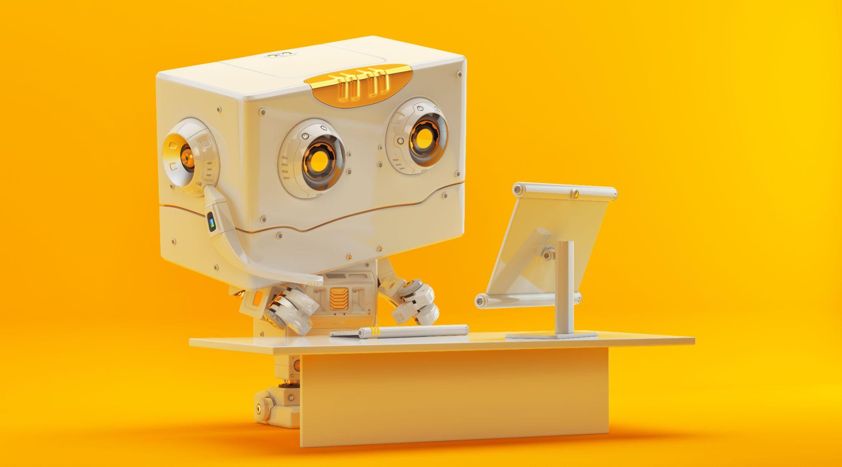
OUR PROGRAM VS
THE REAL WORLD
How would a real-world version of this program be different from our implementation?

Slide 69
A REAL-WORLD IMPLEMENTATION
More sophisticated questions
Gather more patient data (age, weight, height, etc.)
Likely machine learning involved
May give results as a %

Slide 70

OUR DATA VS
THE REAL WORLD
How would data be stored and transmitted differently in a real-world program vs our program?

Slide 71
REAL-WORLD DATA
Store data as a table
Store data in an online database
Encrypted
Password-protected

Slide 72
Conclusion
Nimish Narang
Software Developer

Slide 73

GOALS
Learned how to design and implement an algorithm.
Built a simple dehydration diagnosis bot.

Slide 74

4 STAGES OF PROJECT
MANAGEMENT
Definition
Design
Implementation
Evaluation

Slide 75
WHERE TO GO FROM HERE
Make project more sophisticated.
Strengthen our project by covering all possible edge cases.
Find other similar scenarios to model.
Explore real-world examples of similar algorithms

Slide 76
ZENVA COURSES
Build your own project, learn at your own pace and plan for success!
Notes:
Zenva is an online learning academy with over a million students. We feature a wide range of courses for people who are just starting out, or for people who want to learn something new. Our courses are versatile, allowing you to learn in really whatever way you want. You can choose to view the video tutorials, read the lesson summaries, or even follow along with the instructor with the included project files.

